Slide 2
The Whisper AI
Whisper AI For Subtitles
Async, Threading and Multiprocessing

Slide 3
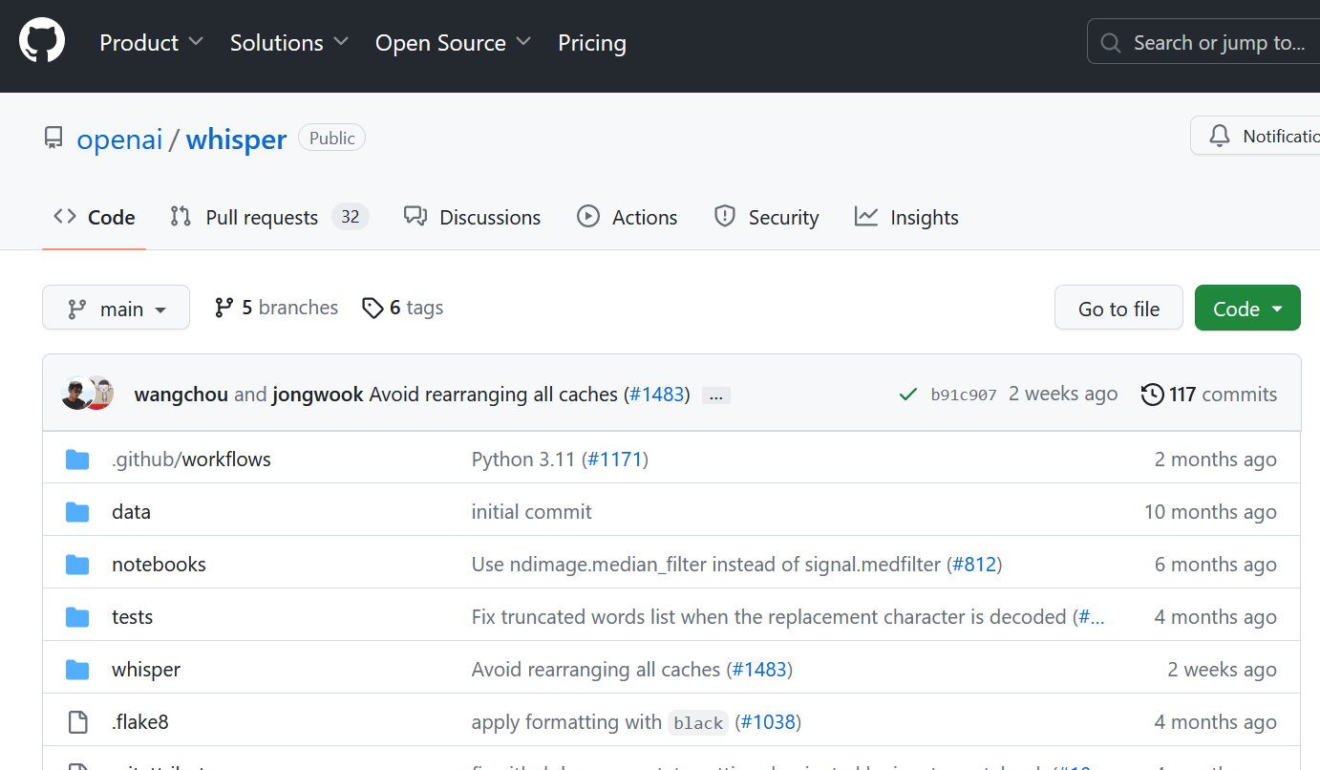
github.com/openai/whisper
Notes:
Last September,
Between StableDiff and ChatGPT, overlooked,
Open Source on Github and HuggingFace

Slide 4
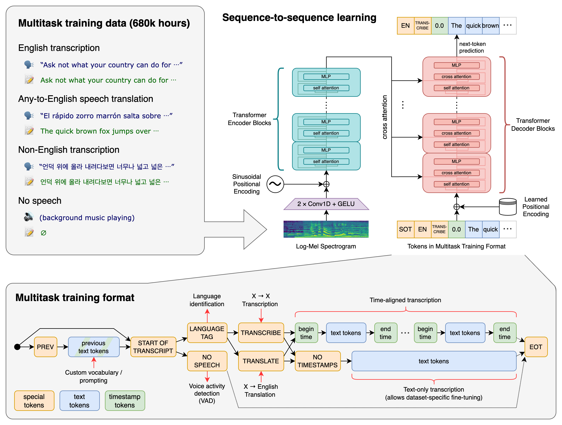
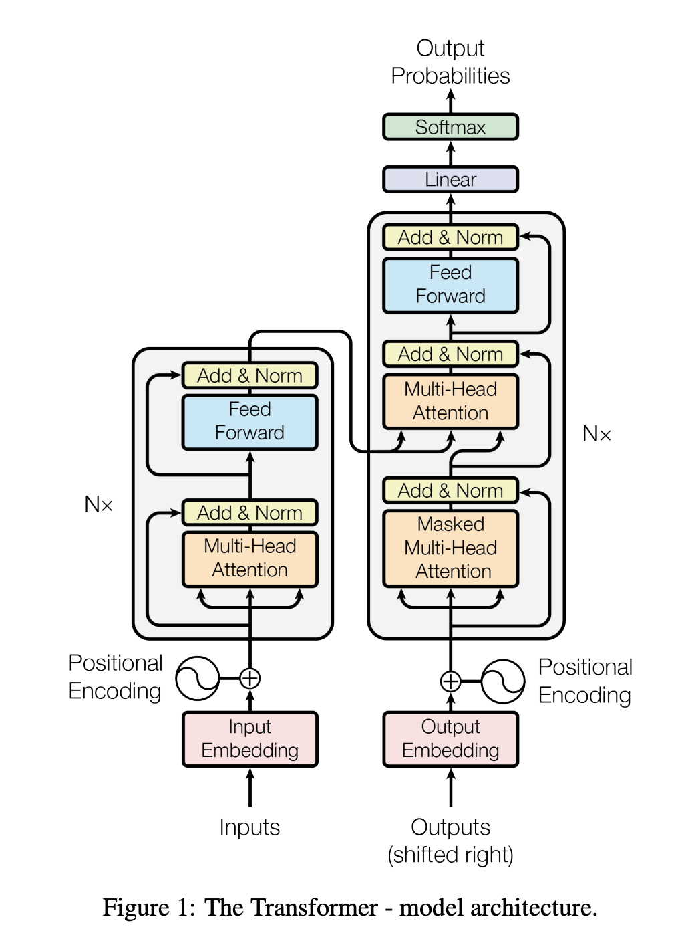
Whisper architecture
Notes:
Overwhelming slide

Slide 5
680,000 hours (117,000 non-English)
125,000 hours X→en translation
Diverse audio input: robust
→ No fine-tuning necessary
Notes:
Training data and hours…
In Intro I did not need to tell which language

Slide 6
Whisper architecture
Notes:
Look at model arch

Slide 7
Whisper architecture
Notes:
Might recognize: GPT: Transformer

Slide 8
Whisper architecture

Slide 9
Whisper architecture
Notes:
Details on tokens.
Talk to me later or read OpenAI blog

Slide 10


Slide 11
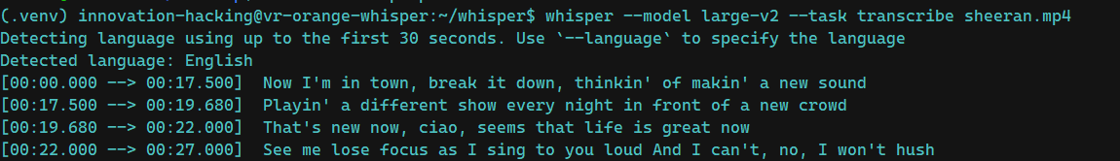
Notes:
Pretty good, right?
Computer at home, mid-range Graphics

Slide 12
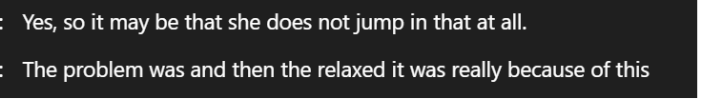
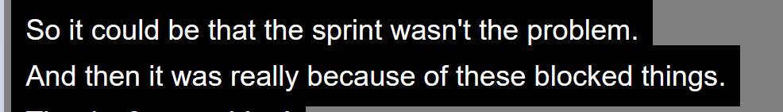
MS Teams transcription
Whisper Subtitles
Cloud
Local
Notes:
Turned Translation on
Whisper in parallel
Scrum meeting
Later more: LOCAL vs CLOUD

Slide 13
Whisper AI For Subtitles

Slide 14
The challenge
Munich based IT Consultancy expanding to EU and Australia
90 % of employees are German. But 5 % don’t understand German
Company update meetings live – only in German
Notes:
Company at the time
Solution then: separate English meeting

Slide 15

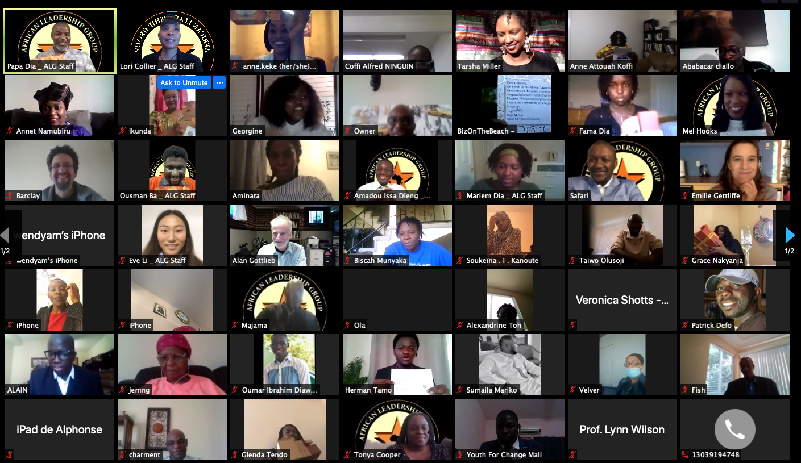

Whisper AI For Subtitles
Zoom meeting
Notes:
Meeting in zoom. Strong GPU in office.

Slide 16

Whisper AI For Subtitles
Whisper AI (in python)
Zoom meeting
Audio

Slide 17

Whisper AI For Subtitles
Whisper AI (in python)
Zoom meeting
Audio
Subtitles
Video

Slide 18
Whisper AI For Subtitles
Whisper AI (in python)
Zoom meeting
Audio
Subtitles
Video
Video with subtitles
Subtitles
“Virtual Camera”
Notes:
German meeting English subtitles

Slide 19

Whisper AI For Subtitles
Whisper AI (in python)
Zoom meeting
Audio
Subtitles
Video
Video with subtitles
Subtitles
“Virtual Camera”

Slide 20
Whisper AI For Subtitles
Record audio
Transcribe with Whisper
Render subtitles
Repeat
Notes:
If naïve: sound is missed

Slide 21
Whisper AI For Subtitles
Render subtitles
Record audio
Transcribe with Whisper

Slide 22
Whisper AI For Subtitles
Render subtitles
Record audio
setTimeout(getNewMessage, 500);
import threading
threading.Thread(target=listen_forever, args=(phrase_time_limit, audio_queue)).start()
threading.Thread(target=transcribe_forever, args=(language, task, audio_queue, result_queue)).start()
Transcribe with Whisper

Slide 23
Whisper AI For Subtitles
Render subtitles
Record audio
temp.wav
Transcribe with Whisper
+1s
+1s
+1s

Slide 24
Whisper AI For Subtitles
Render subtitles
Record audio
import queue audio_queue = queue.Queue()
temp.wav
Transcribe with Whisper
+1s
+1s
+1s

Slide 25
Whisper AI For Subtitles
Render subtitles
Record audio
temp.wav
Transcribe with Whisper
+1s
+1s
+1s

Slide 26
Whisper AI For Subtitles
Render subtitles
Record audio
Hello and welcome to my talk.
temp.wav
Transcribe with Whisper
Thank you for listening
+1s
+1s
+1s

Slide 27
Whisper AI For Subtitles
Render subtitles
Record audio
Hello and welcome to my talk.
temp.wav
Transcribe with Whisper
Thank you for listening
+1s
+1s

Slide 28
Whisper AI For Subtitles
Render subtitles
Record audio
Hello and welcome to my talk.
temp.wav
import queue result_queue = queue.Queue()
Transcribe with Whisper
Thank you for listening
+1s
+1s

Slide 29
Whisper AI For Subtitles
Render subtitles
Record audio
Polling
Hello and welcome to my talk.
temp.wav
import queue result_queue = queue.Queue()
Transcribe with Whisper
Thank you for listening
+1s
+1s
Partly implemented in https://github.com/mallorbc/whisper_mic

Slide 30
Threading vs Multiprocessing
Threads
Shared Memory
Communicate via Queue
Asynchronous code
Do NOT run at the same time (GIL)
Processes
Multiple isolated python instances
Communicate via Queue and Pipe
Multi-core execution
Notes:
Threads: OS level. Shared Mem: references in Queue!
Processes: pickled!
Why I use Threads?

Slide 31
Threading vs Multiprocessing
Threads
Shared Memory
Communicate via Queue
Asynchronous code
Do NOT run at the same time (GIL)
Processes
Multiple isolated python instances
Communicate via Queue and Pipe
Multi-core execution
Record audio
Transcribe with Whisper
Render subtitles
Repeat

Slide 32
Threading vs Multiprocessing
Threads
Shared Memory
Communicate via Queue
Asynchronous code
Do NOT run at the same time (GIL)
Processes
Multiple isolated python instances
Communicate via Queue and Pipe
Multi-core execution
async / await
Notes:
Async: new version

Slide 33
What’s next?

Slide 34
Whisper AI
Notes:
Speed
Data safety
Privacy
Too heavy for today

Slide 35
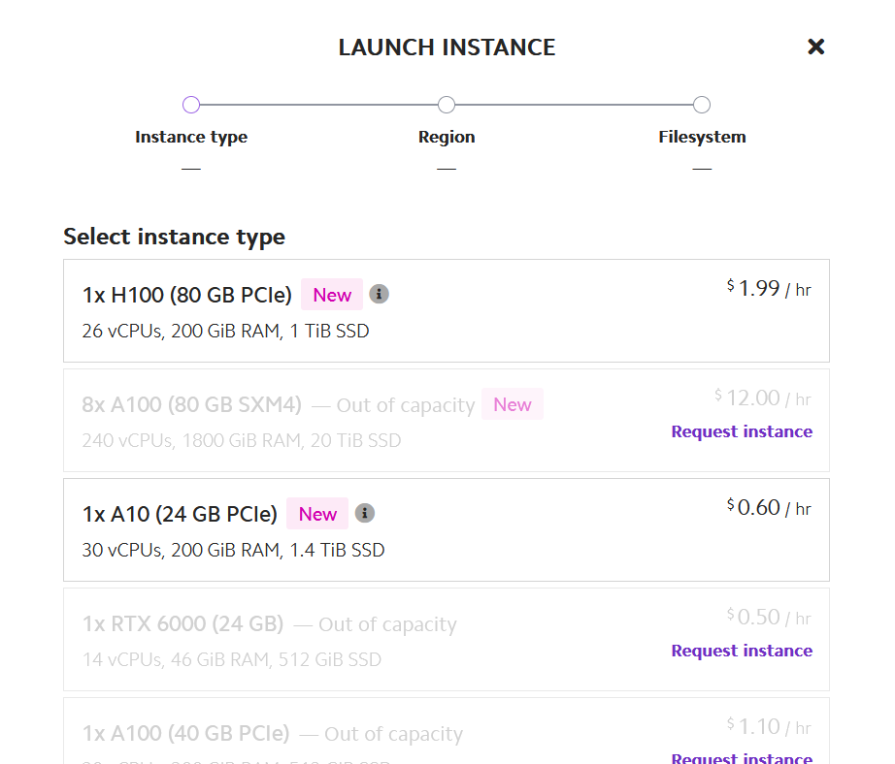
lambdalabs.com
github.com/tatellos/whisper-stream

Slide 36
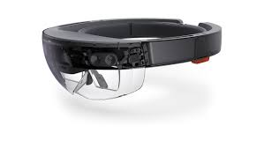
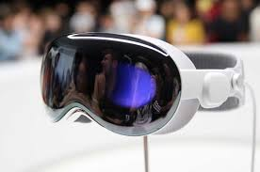
Notes:
My dream: understand everybody
If you have this, message me

Slide 37

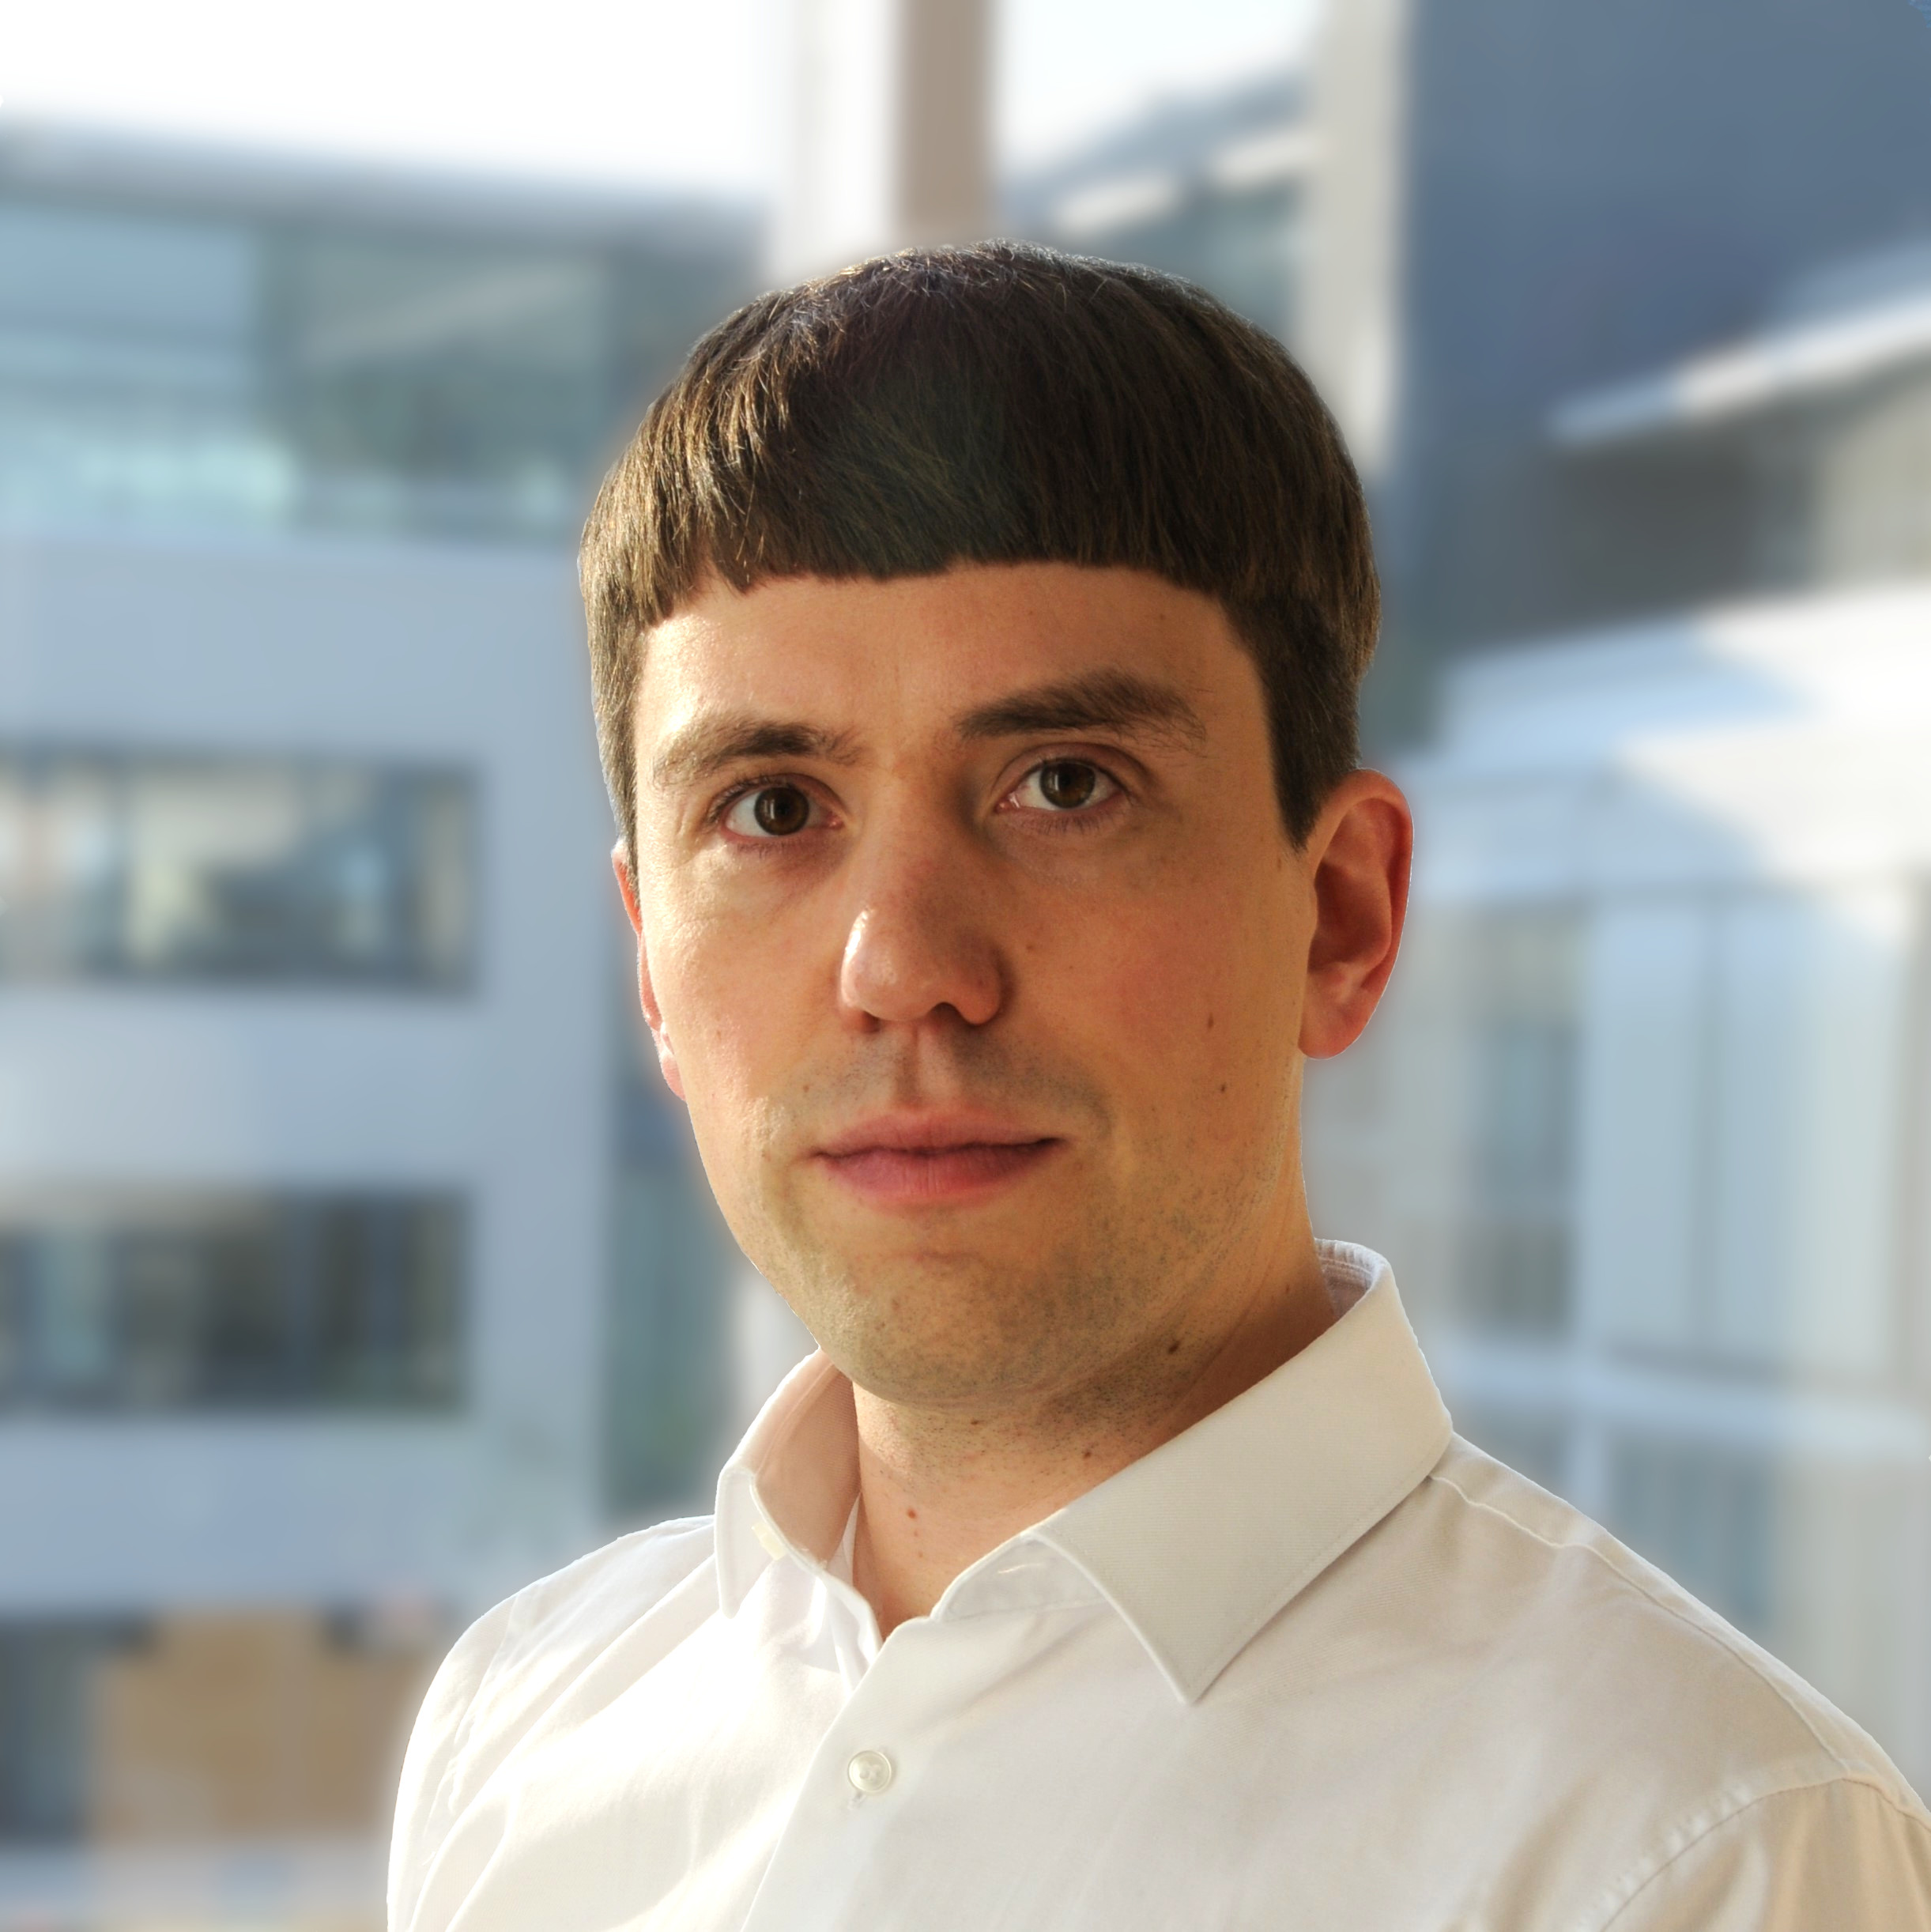
tatellos@arens.ma
github.com/tatellos/whisper-stream
linkedin.com/in/mathias-arens-msc

